Slide 1
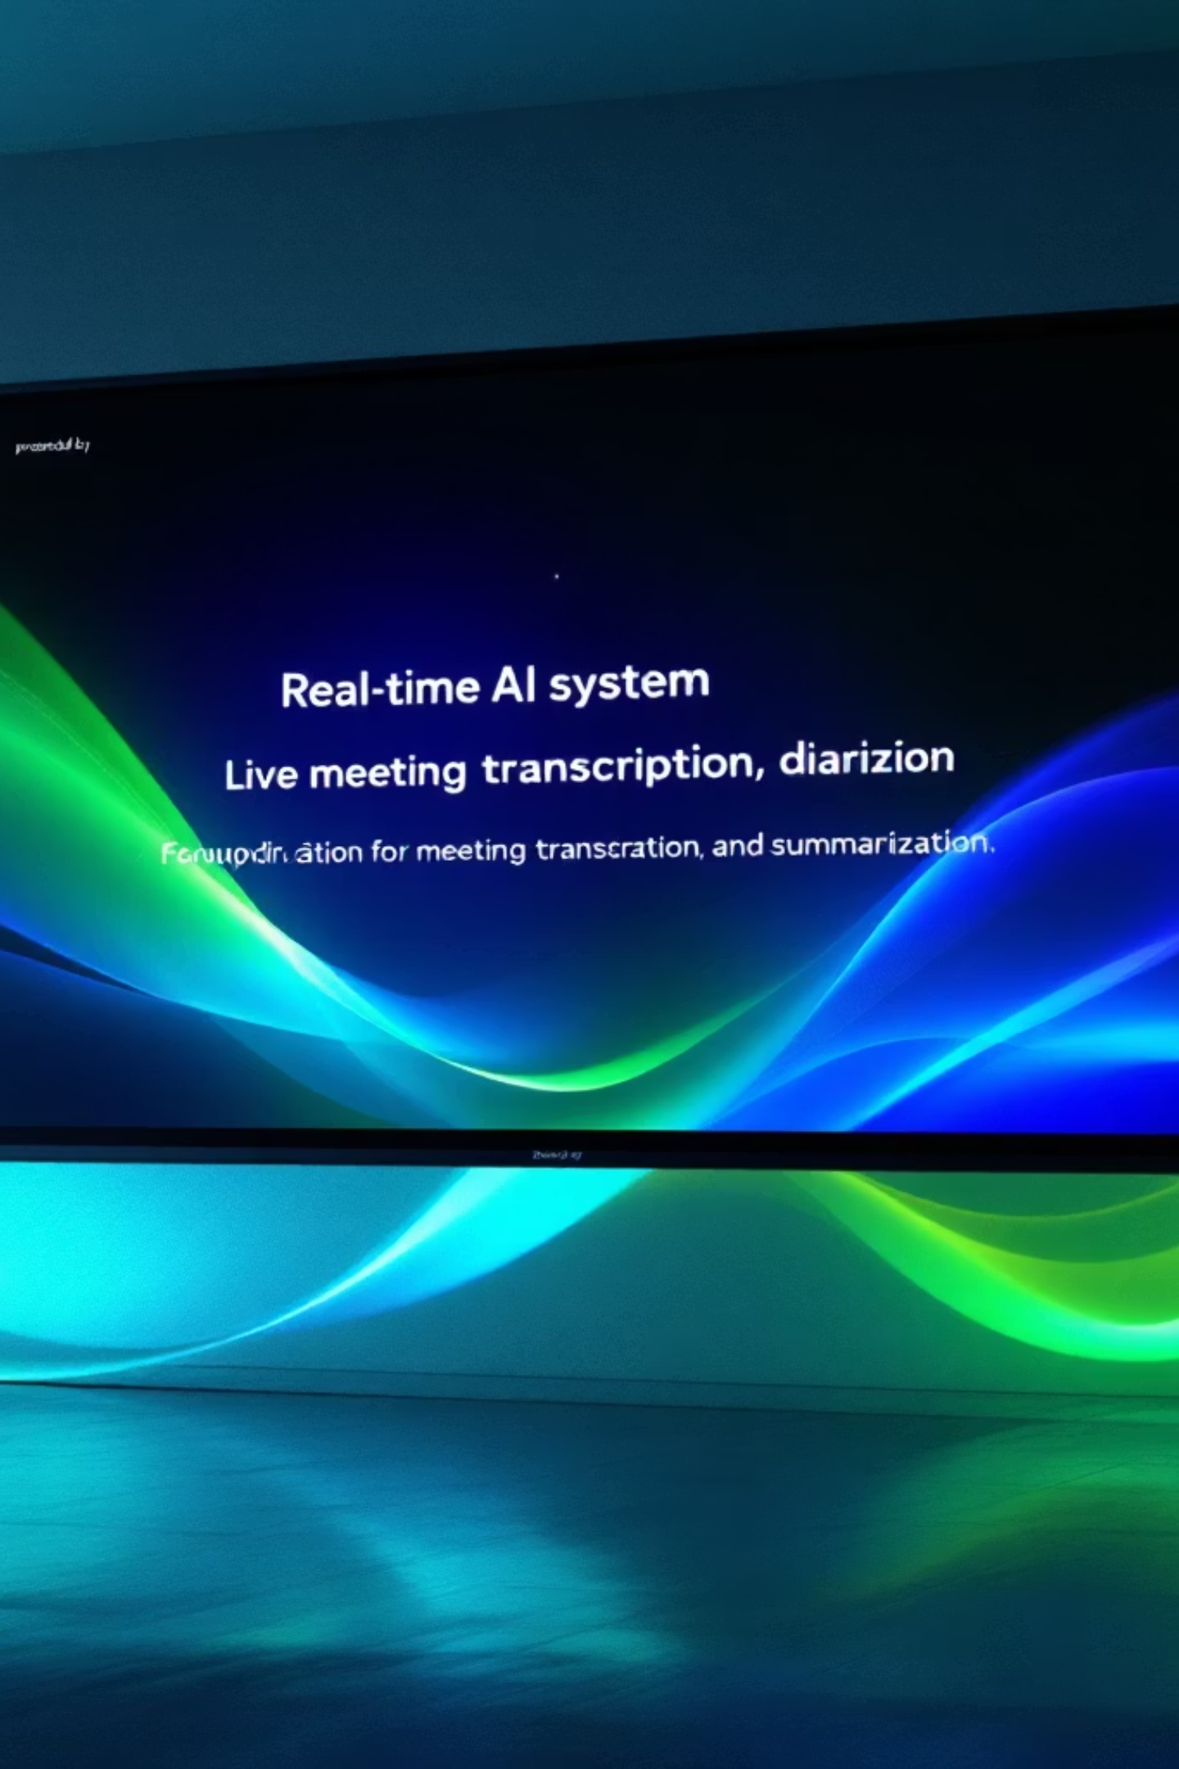
INFOSYS AI VIRTUAL INTERNSHIP
Live Meeting Summarizer Application
A Real-Time AI System for Transcription, Diarization & Summarization
Presented by: Soumodip Ghosh

Slide 2

The Meeting Overload Problem
Unstructured Audio
Lost Information
Live meetings generate vast amounts of unstructured audio, making post-meeting review incredibly difficult and time-consuming.
Manual note-taking is prone to errors, often missing critical discussion points and failing to accurately attribute statements to speakers.
Lack of Integration
Urgent Need for Automation
There's a critical gap in the market for an integrated local system that seamlessly combines real-time Speech-to-Text (STT), speaker diarization, and AI summarization into one coherent workflow.
Teams require a tool that can instantly generate accurate meeting summaries, speaker-attributed transcripts, and downloadable reports, transforming raw audio into actionable insights.

Slide 3






Project Objectives: Crafting the Solution
Real-time Audio-to-Text
Automatic Speaker Diarization
LLM-Powered Summarization
Develop a robust system leveraging offline STT models for immediate transcription.
Implement advanced algorithms to accurately identify and label who said what.
Generate structured, intelligent summaries of entire meetings using state-of-the-art Large Language Models.
Intuitive Streamlit Interface
One-Click Export & Delivery
Seamless Pipeline Execution
Design a user-friendly web interface that displays live STT and comprehensive meeting outputs.
Enable effortless export to PDF/Markdown and direct email distribution of summaries and transcripts.
Ensure the entire process flows smoothly from "Start" to "Stop" to "Summary" without interruption.

Slide 4
Technology Stack: Tools & Libraries
Speech-to-Text
Librosa, Whisper, PyAudio, SoundDevice
Speaker Diarization
Pyannote.audio, Torchaudio, Hugging Face pretrained pipelines
Summarization
Groq LLaMA 3.1, HuggingFace Transformers
Frontend
Streamlit
Backend Processing
Python Threading,Queue Pipelines
Export & Logging
Markdown, PDF

Slide 5





Complete Workflow: From Audio to Insight
Start Recording
Speech-to-Text
Diarize Audio
Summarize & Export

Slide 6

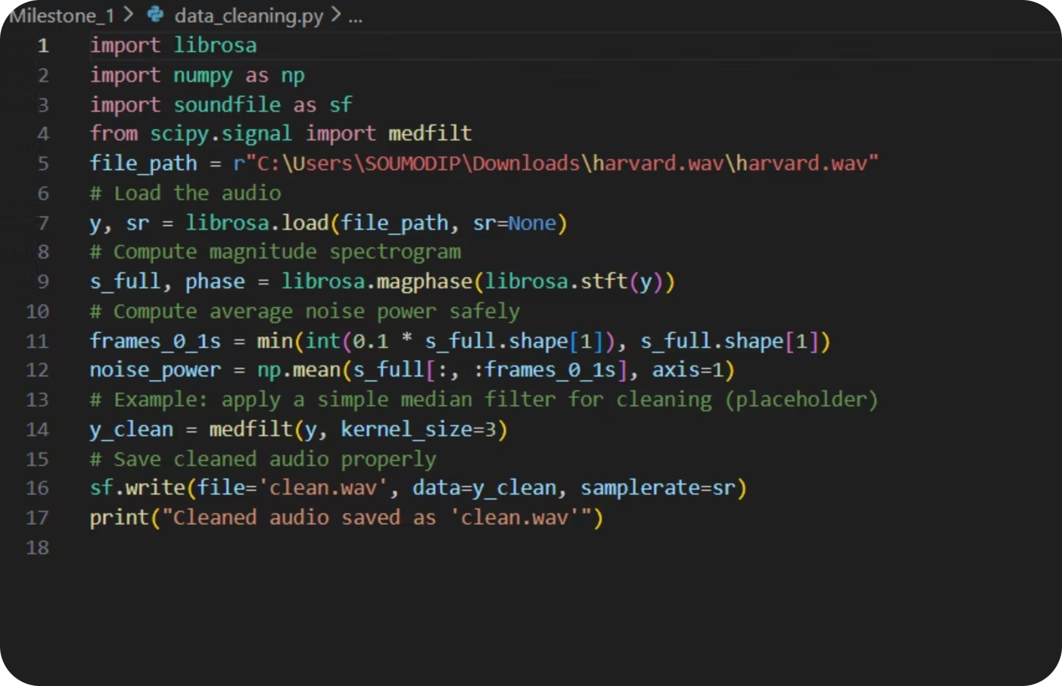
Milestones Achieved: Foundation & Intelligence
Milestone 1: Speech-to-Text System
Milestone 2: Diarization + Summarization Engine
Implemented real-time microphone streaming with efficient multithreaded capture.
Successfully integrated the Pyannote.audio diarization pipeline, achieving a Diarization Error Rate (DER) of less than 10 %.
Integrated cutting-edge Whisper/Librosa models, achieving a Word Error Rate (WER) of less than 15% on the AMI dataset.
Developed a mechanism to convert raw audio segments into clean, speaker-labeled transcripts.
Developed a robust benchmarking setup comparative accuracy analysis across various models.
Crafted optimized prompts for LLaMA summarizers to ensure high-quality output.
Ensured stable, low-latency real-time transcription for a seamless user experience.
Achieved a ROUGE score of greater than 0.4, delivering structured, speaker-aware summaries.

Slide 7





Milestone 3: Seamless Integration & Workflow
Core Objectives
Integration Workflow
Achieve perfect synergy by combining STT, diarization, and summarization into one unified pipeline.
Streamlit UI
Ensure summarization triggers only after the "Stop" command, processing the complete transcript.
Provide a dynamic, real-time STT display on the user interface during live meetings.
Start Recording → Live STT
Guarantee a smooth, deadlock-free user flow, eliminating race conditions for optimal performance.
Stop Recording → Diarization Engine
Merged Transcript → LLM Summarization
Final Summary + Transcript Rendered on UI

Slide 8

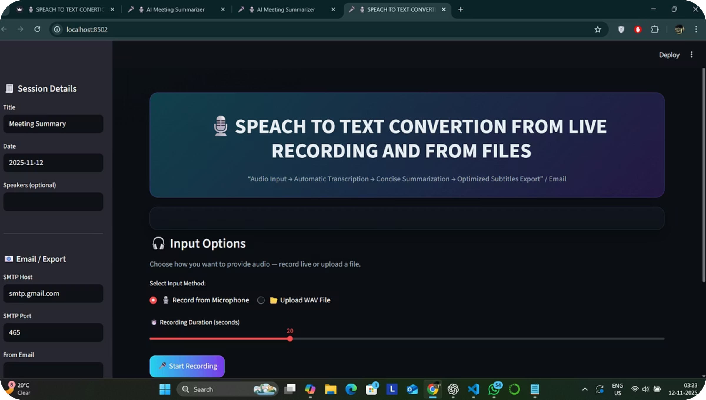

The Result: An Intuitive AI Dashboard
A glance at the future of meeting management.
This dashboard provides a comprehensive view: live STT stream, speaker-tagged transcript, final AI summary, and convenient export/email options.

Slide 9
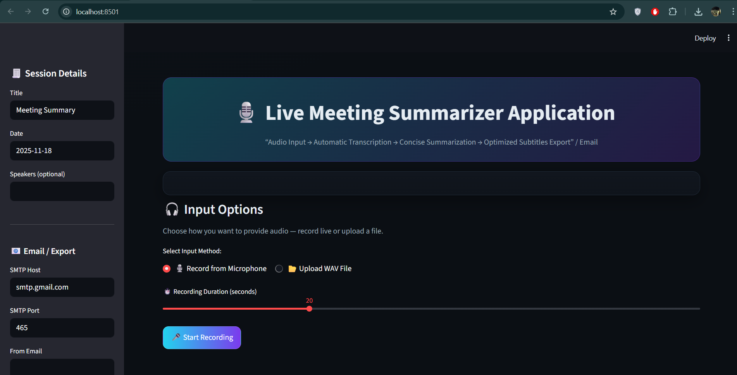
The Result: An Intuitive AI Dashboard

Slide 10








Future Scope: Expanding Capabilities
Multilingual Support
Enhanced Insights
Scalable Deployment
Implement transcription, diarization, and summarization across multiple languages.
Integrate action-item extraction, decision tracking, and sentiment analysis for deeper meeting intelligence.
Deploy a robust backend using Docker, Kubernetes, and cloud GPU inference for enterprise-grade scalability.
Mobile Accessibility
Platform Integration
Historical Analysis
Develop a mobile application with background recording capabilities for on-the-go meeting support.
Enable live transcription and summarization for popular platforms like Google Meet, Zoom, and MS Teams.
Implement database-supported meeting history with search functionality and advanced analytics.
Advanced Search
Utilize vector embeddings for intelligent topic search and retrieval across vast archives of past meetings.

Slide 11
Conclusion & Validated Test Results
Conclusion
Test Results Summary
Successfully developed a comprehensive pipeline encompassing Speech-to-Text → Diarization → Summarization.
Extensive testing conducted on both the AMI Meeting Corpus and diverse synthetic datasets.
Diarization accuracy rigorously validated across various multi-speaker scenarios.
Achieved and validated key performance targets: WER < 15%, DER < 10 %, and ROUGE > 0.4.
Summarization outputs assessed and optimized through a combination of ROUGE, BLEU scores, and qualitative human evaluation.
The system effectively transforms lengthy meetings into concise, structured summaries with clear speaker attribution.
The intuitive Streamlit UI ensures a smooth, real-time user experience, complete with one-click export features.

Slide 12
Thank You

